Slide 1


Team Westeros Presents
AI Powered Automated Candidate Evaluator
December , 2025

Slide 2

Our Enthusiastic team consists of diligent members who put their effort, gave their best and learned valuable AI lessons throughout this journey ☺
Somesh Bhawnani – Skechers USA Account
Ayush Mangal – Stellantis Account
Saurabh Awasthi – Ultimatix Account
Shivani Singh – Ultimatix Account
Shivani Singh - Ultimatix Account

Slide 3


Problem Statement
Defining the Challenge We Address
Summary: When a candidate applies for a job, the technical assessment questions must be generated based on the skills experience and role expectations. Generate relevant coding challenges for the candidates to solve. Based on thew scoring, generate a report if the candidate is recommended/rejected and the rationale for the decision.
Problem/Challenge being addressed: Traditional technical assessment process is often based on the knowledge on the technical panel and sometimes confined only to the client expectations. The objective is to eliminated such bias and ensure that the assessment process is transparent.
Data Requirements:
Candidate Skills, Job description, Skill based questions and response
Expected Outcome:
Questions/Code challenges must be random relevant to skill, JD and experience levels
Generate assessment report highlighting strengths and weaknesses
Generate a report for recommendations/rejection including rationale

Slide 4
Thought Process
Analyzing the Problem and Approach
Our team engaged in extensive brainstorming sessions to dissect the problem, exploring various technologies and methodologies to ensure a robust solution that meets all requirements.
#thinking like a customer
Usability – Ease of use
Use Cases – Multiple Use cases covered
Team accomplishes more – Divided work to complete tasks quickly, efficiently
Collaboration, Training – Spent time at AI Lab, had multiple meetings
Working Product at the end of the demo ☺

Slide 5
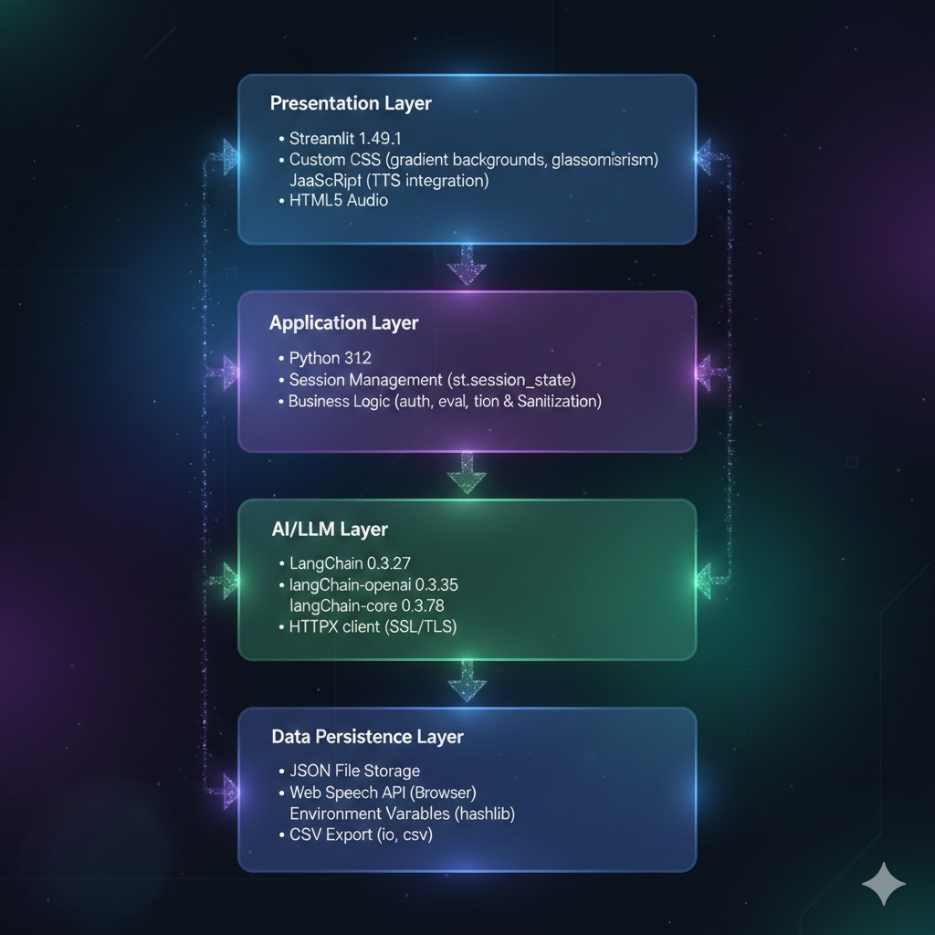

Overall Solution Design and Architecture
Visualizing our innovative system's components
This architecture supports scalable and efficient AI solutions.

Slide 6



AI Guardrails for Trust
Ensuring Safety, Ethics, and Reliability
Implementing robust guardrails is crucial for maintaining trustworthy AI systems that prioritize fairness, ethics, and reliability in decision-making processes.
User Disclaimer
Key Security
Context Awareness
Code Annotations
PII Data masking
Human in loop

Slide 7



Future Innovations and Scalability
Scalability
Feature Enhancements
Adaptability
We will enhance performance with cloud deployment strategies.
Video recordings, Avatars, multiple modes – mobile, desktop, web etc.
System to have its own knowledge base, dashboards, KPIs, Audits etc

Slide 8
Thank You!

Slide 9
Technology Stack
- Framework: Streamlit 1.29.0
- AI/LLM: DeepSeek Chat API via LangChain
- Authentication: SHA256 password hashing
- Database: JSON file storage
- Voice: Web Speech API (TTS), audio-recorder-streamlit (STT)
- Styling: Custom CSS with gradient backgrounds
Complete Assessment
- Answer 5 questions (mix of conceptual and coding)
- Use voice mode for audio questions/answers (optional)
- Get instant feedback after each answer
- 10 minutes per question timer
Question Distribution
- **Question 1-2**: Conceptual/Theoretical
- **Question 3**: Coding Challenge
- **Question 4**: Conceptual/Theoretical
- **Question 5**: Coding Challenge
## 📊 Scoring System
Each question scored 0-20 points based on:
- **Conceptual Questions**: Accuracy, completeness, depth
- **Coding Questions**:
- Correctness (8 pts)
- Code Quality (4 pts)
- Efficiency (4 pts)
- Edge Cases (4 pts)
### Final Recommendation
- **80%+**: Strong Hire ✅
- **60-79%**: Recommended with upskilling 👍
- **40-59%**: Not Recommended ⚠️
- **<40%**: Not Recommended ❌

